Slide 1
Software Engineering for Geoinformatics
SE4GI
GeoApp

Slide 2
Group 5
Ali B. Mohmmed
Hussamalden M. Shereif
Mazin A. Saeed
Nizar O. Fadl Elseed
Nshwan A. Khairalla

Slide 3
Introduction
Geoapp:
Geoapp is a web application deal with geospatial data which is imported from epicollect5 and related to north Rupununi wetland Guyana area located in south America.
Area of study:
The North Rupununi is located in south-west Guyana consisting of a mixture of forest, savannah and wetlands and is considered one of the most diverse areas in South America.
App scope:
Provides information to users (Specialist/researchers in wetland) about a good example of wetland area and gives them some access and tools offered by a web application let them display, process and analyze the wetland details and links them together in some processes.

Slide 4
App development steps
The application was developed in three main steps:
1.Framing RASD document.
2. Framing Design document.
3.Excute and develop the software design.

Slide 5
RASD
RASD: Requirements Analysis and Specification Document RASD document is a document which describes and determine the goal, scope, domain analysis, use cases, phenomena and all the requirements of building a specific web application.

Slide 6
Requirements
Functional Requirements.
The system will offer different layers of data with base map
The system shall allow members to interact with analysis graphs
The system shall allow members to add and manipulate data and comments
Non-functional Requirements.
The system should be available for24/7.
The system should return a feedback within a 5 second window
Technical Requirements.
The dataset is provided by Epicollect5.
The software should be coded in python language.
The system should be available as web application that can be used throughout the web browser

Slide 7
Use cases
Registration.
Login.
Add data.
Visualization.
Analysis.
Add comment.
Edit comment.
Delete comment.
Logout.

Slide 8
Design Document
Design document is a document which explains in more details of the software structure,technologes, functions and all templates of a piece of software and guide the developers team to build and develop their app

Slide 9
App Structure
Database server:
The software use SQL postgres as database management system (DBMS)that create tables, manage, retrieve, and store data that work in local machine.
Web server:
This server takes the request from client and provide the response.
WSGI server:
WSGI (Web Server Gateway Interface) is the standard interface that the web server must implement in order to be able to execute python code.

Slide 10
Modules & packages
Flask: contains the main application codes which are responsible for the Interaction between the template engine, the database, the server and the functions in between, so it is the backbone of this web application.
Render_ template: render template is a Flask function from the flask. Templating package used to generate output from a template file based on the Jinja2 engine that is found in the application's templates folder.
Jinja: Jinja is a fast, expressive, extensible templating engine. Special placeholders in the template allow writing code like Python syntax. The Jinja template engine allows customization of tags, filters, tests, and globules. it uses mainly HTML pages as user interface, it is dynamically building HTML pages using familiar Python.

Slide 11
Modules & packages
Psycop2: Psycopg is the most popular PostgreSQL database adapter for the Python programming language. It is designed for multi-threaded applications and manages its own connection pool. The software use psycopj2 to connect with the database.
Session: The session object lets you to keep track of parameters across requests, so track and remember data from request to request.
Request: The requests module allows you to send HTTP requests using Python. The HTTP request returns a Response Object with all the response data (content, encoding, status, etc.)

Slide 12
Libraries &statistical and geospatial analysis
Json:
Json is an open standard file format and data interchange format that stores and transmits data objects made up of attribute-value pairs and array data types using human-readable text (or any other serializable value). the software uses Json for acquiring data from Epicollect5 and transfer it to pandas data frame.
Bokeh:
Bokeh is a Python library for creating interactive visualizations for modern web browsers.
Geopandas:
Geopandas make working with geospatial data in python easier.

Slide 13
HTML Templates
Register user.
Login.
Add data.
Visualization.
Analysis.
Add comment.
Edit comment.
Delete comment.
Logout.

Slide 14
gGrazie,,,

Slide 15
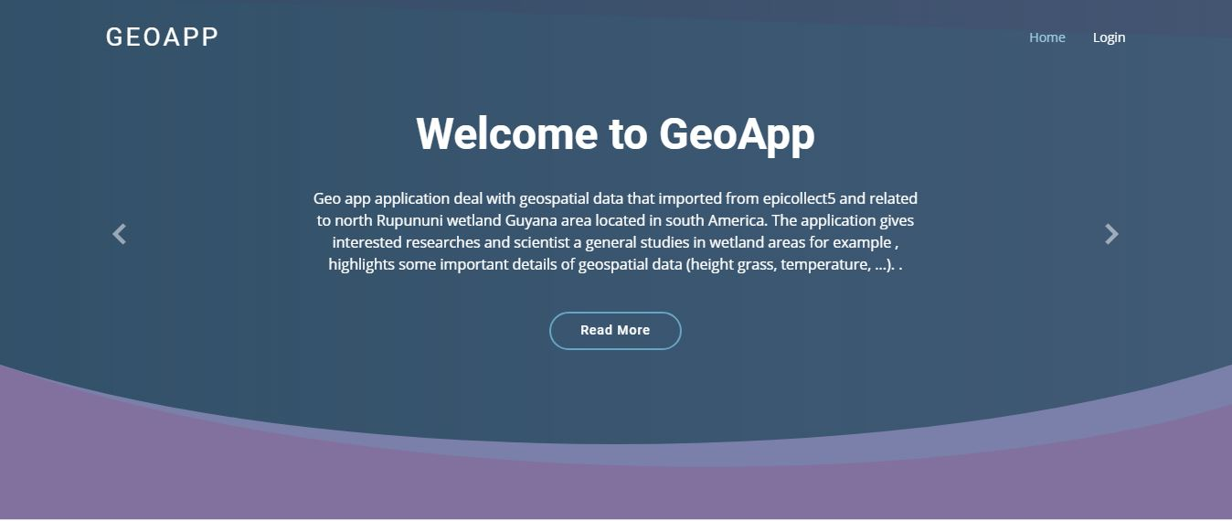
Welcome to GeoApp

